Slide 1

StreetCare AI
Serving layer: REST API & Streamlit dashboard
Individual presentation · Theme lead for API and Streamlit (Day 5)
PRESENTED BY
Mansavi Aggarwal

Slide 2

Agenda
01
My role and what I owned
02
Where the serving layer fits
03
Service start-up and the 11 endpoints
04
Security: sign-in, roles and districts
05
Validation, errors and the review lifecycle
06
The Streamlit dashboard
07
Testing, results and learnings
2

Slide 3

My role: API and Streamlit
Day 5 of the build – turning the data, models and agents into a secured service and a dashboard people can use
11
REST endpoints
3
roles, 5 permissions
5
dashboard pages
75
API requests tested end to end
Files in my theme
What my layer must guarantee
File | What it does
access/permissions.py | token → account, role permission, district rule
api/schemas.py | request and response shapes (Pydantic)
api/routes.py | 11 endpoints, guard, failure handler
run_api_service.py | checks build outputs, starts FastAPI
dashboard/*.py | API client, sign-in, five pages
run_dashboard.py | navigation by role, sign-out
One entry point
every figure the dashboard shows comes from the service
Secure by default
one guard on every route; it cannot be forgotten
Safe AI spend
refusals happen before any Gemini call
Honest failures
a failed run is marked FAILED, nothing half-stored
Right person decides
only an inspector of the street's district, not the opener
3

Slide 4
Where the serving layer fits
Layers 6 and 7 sit on top of the deterministic tools, the models and the agent workflow
7
Streamlit dashboard
5 pages · display only · no business rule
My layers
• Highlighted in coral
• Call into every layer below through one function each
• Hold no rules of their own – the same report gives the same answer from a browser, a script or the tests
6
REST API (FastAPI)
11 endpoints · token · role · district · 401/403/404/409/422/502
5
Agentic workflow
LangGraph · 7 Gemini agents · human gate
4
Screening engine
requirements · triggers · assessment
3
Knowledge base
16 PDFs → 205 passages in ChromaDB
2
ML models
repeat · crew hours · sentence
1
Data layer
cleaning pipeline · SQLite (6 tables)
4

Slide 5
How one request flows
Browser → dashboard → API client → guard → endpoint → tools / workflow / chat → database
Person
Streamlit page
call_service
Guard
Endpoint
Core
signs in on the dashboard
builds the request
adds X-Session-Token, timeout, spinner
token → role → district
validated by Pydantic
tools · workflow · chat
The guard, step by step
401
No token, unknown or replaced token
Sign in first
403
Role lacks the route's permission
The … role does not include the … permission
403
Inspector acting outside own district
… is appointed for North and may not act on report …
422
Request shape is wrong
field-level list from Pydantic
Only after all four checks pass does the endpoint run – so a refused request never reads data or spends an AI call.
5

Slide 6
Service start-up and the 11 endpoints
run_api_service.py refuses to start until every build output exists; the queue is computed once at start-up
Endpoint | Purpose | Permission | Success | AI calls
POST /auth/signin · /auth/signout | session token, one per account | public | 200 | 0
GET /queue?defect_type= | ranked queue (footway first) | queue | 200 | 0
GET /queue/{report_reference} | everything about one report | queue | 200 | 0
POST /reviews | run 5 agents → review at the gate | review | 201 | 5
GET /reviews?status_value= | reviews by status | audit | 200 | 0
POST /reviews/{id}/decision | resume the paused run | decision | 200 | 0–2
GET /reviews/{id}/calls | call budget: calls, tokens, latency | audit | 200 | 0
POST /chat/ask · GET /chat/turns | chat and own conversation | chat | 200 | 1 · 0
GET /audit/chat-turns | everyone's latest turns | audit | 200 | 0
13
required files checked before start (data, models, index, database)
40
open reports ranked and screened once at start-up
1
lock per report – no double review or double decision
6

Slide 7
Security: sign-in, roles and districts
The service – not the dashboard – decides who may do what
Authentication
Authorisation: role × permission
Password hashing
Permission | Inspector | Coordinator | Adviser
queue | ✓ | ✓ | –
review | ✓ own district | ✓ | –
decision | ✓ not own review | – | –
audit | ✓ | ✓ | –
chat | ✓ | ✓ | ✓
PBKDF2-HMAC-SHA256 · 200,000 rounds · 16-byte salt per account
Same answer for every failure
unknown user and wrong password both get 401 – no username probing
Constant-time compare
hmac.compare_digest on the stored hash
One session per account
24-byte URL-safe token; signing in again ends the old one
Accounts and pages
Permission lookup from the method + route template, e.g. POST /reviews/{review_id}/decision → decision
District rule an inspector may only open or decide reports on the 12 streets of their own district
Role | Accounts | Dashboard pages
Highways Inspector | 8 (2 per district) | all 5
Street Care Coordinator | 4 | queue · detail · audit · chat
Customer Services Adviser | 4 | chat only
7

Slide 8
Validation and errors – tested on the running service
75 captured requests: every success and every refusal answered with the right status and message
Code | Meaning | Example message
401 | who are you? | Sign in first
403 | not allowed | role / district refused
404 | not found | No open defect report has …
409 | conflicts with record | already reviewed / decided
422 | wrong shape | String should have at least 10 …
502 | AI or rule failure | run marked FAILED
Pydantic first
One failure handler
Nothing half-stored
lengths, the 6 queue filters, 4 statuses, 3 decisions and turn limits are refused with 422 before any work
ValueError, Gemini and HTTP errors become a 502 with the failure's own message
a run opened by the failing request is marked FAILED; the report can be reviewed again
8

Slide 9
The review lifecycle through the API
Captured end-to-end run on report SC0052125 (footway, Market Place, Town Centre)
POST /reviews
GET /reviews/{id}/calls
POST …/decision
POST …/decision
POST …/decision
amelia (Town Centre)
coordinator
amelia – her own review
priya – North district
owen – Town Centre
201 · 5 AI calls
200
409
403
200 · +2 AI calls
review AWAITING_DECISION
5 of 5 calls expected
opener may not decide
street outside district
REPAIR_ORDERED, 7 of 7
Why the API checks first
• Conflict and refusal checks run under the report's lock, before the paused run resumes
• A refused decision costs no AI call and changes nothing
• Sending the same decision again finishes a run whose document step failed
• A second review of the same revision → 409
9

Slide 10
The Streamlit dashboard
Five pages over the API, shaped by role – the dashboard holds no business rule
Page | Who | What it shows and does
Report queue | Inspector, Coordinator | counts, defect-type filter, ranked table; selecting a row opens the detail
Report detail | Inspector, Coordinator | screening, statement evidence, report answers, review; start a review
Decision queue | Inspector | own district's waiting reviews; decision form with only the open decisions
Audit trail | Inspector, Coordinator | reviews by status, documents, call budget, everyone's chat turns
Street care chat | everyone | own conversation badged by type, with sources; ask box
One client
Same limits as the API
Navigation by role
Colour badges
call_service adds the token, shows a timed spinner only for AI calls, ends the session on 401
5–1000, 10–1000 and 3–1000 characters, so a form the API would refuse is never sent
only the pages the API returned for the role; before sign-in only the sign-in page exists
decision, status, likelihood band, chat type and requirement result
10

Slide 11
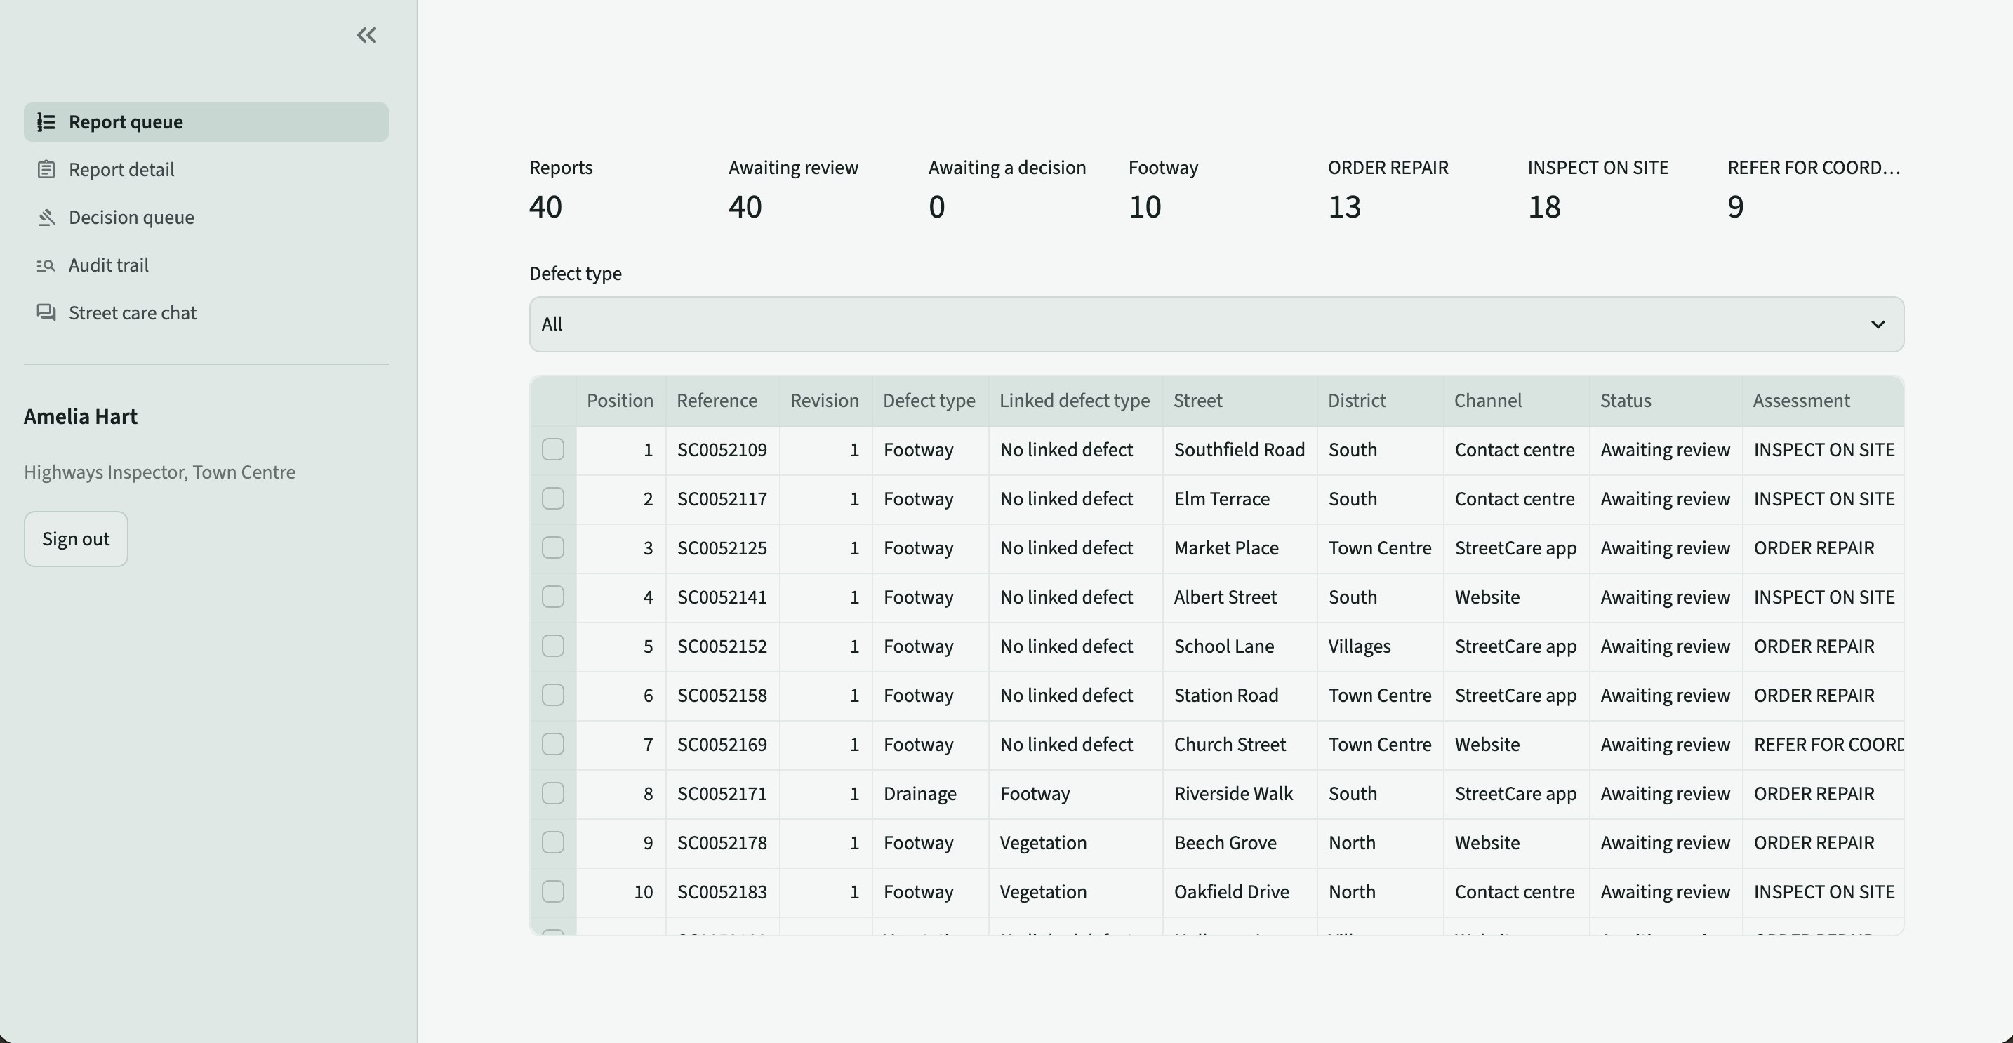
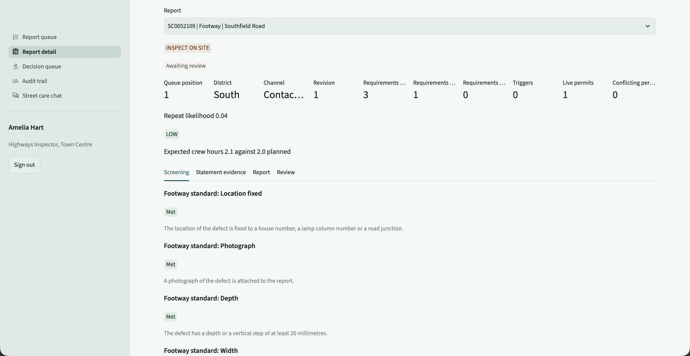
Dashboard – queue and report detail
Signed in as Amelia Hart, Highways Inspector for Town Centre
Report queue
Report detail – screening tab
40 reports
Footway first
Figures from the API
Start a review
13 order · 18 inspect · 9 refer
trip hazards lead the queue
likelihood band, crew hours, permits
one call runs the 5 agents
11

Slide 12
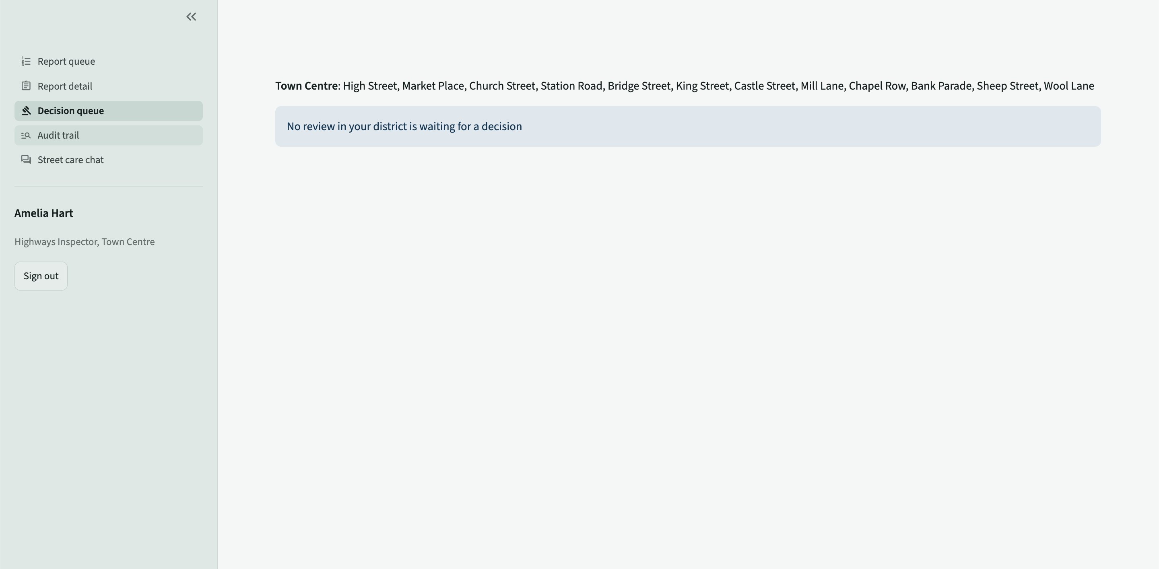
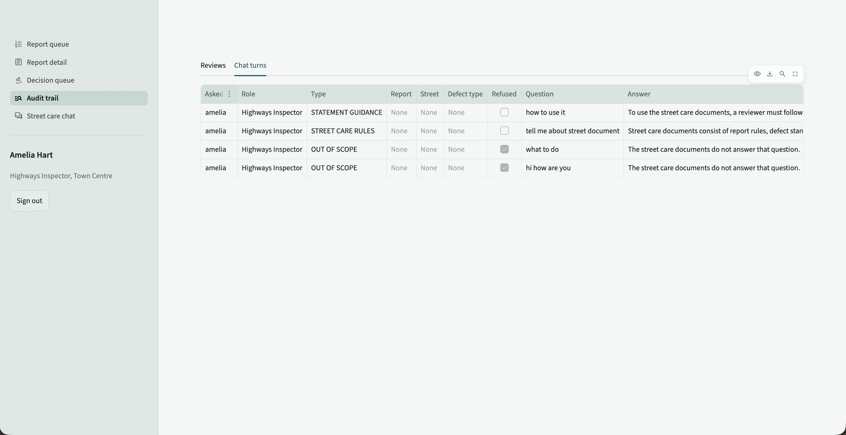
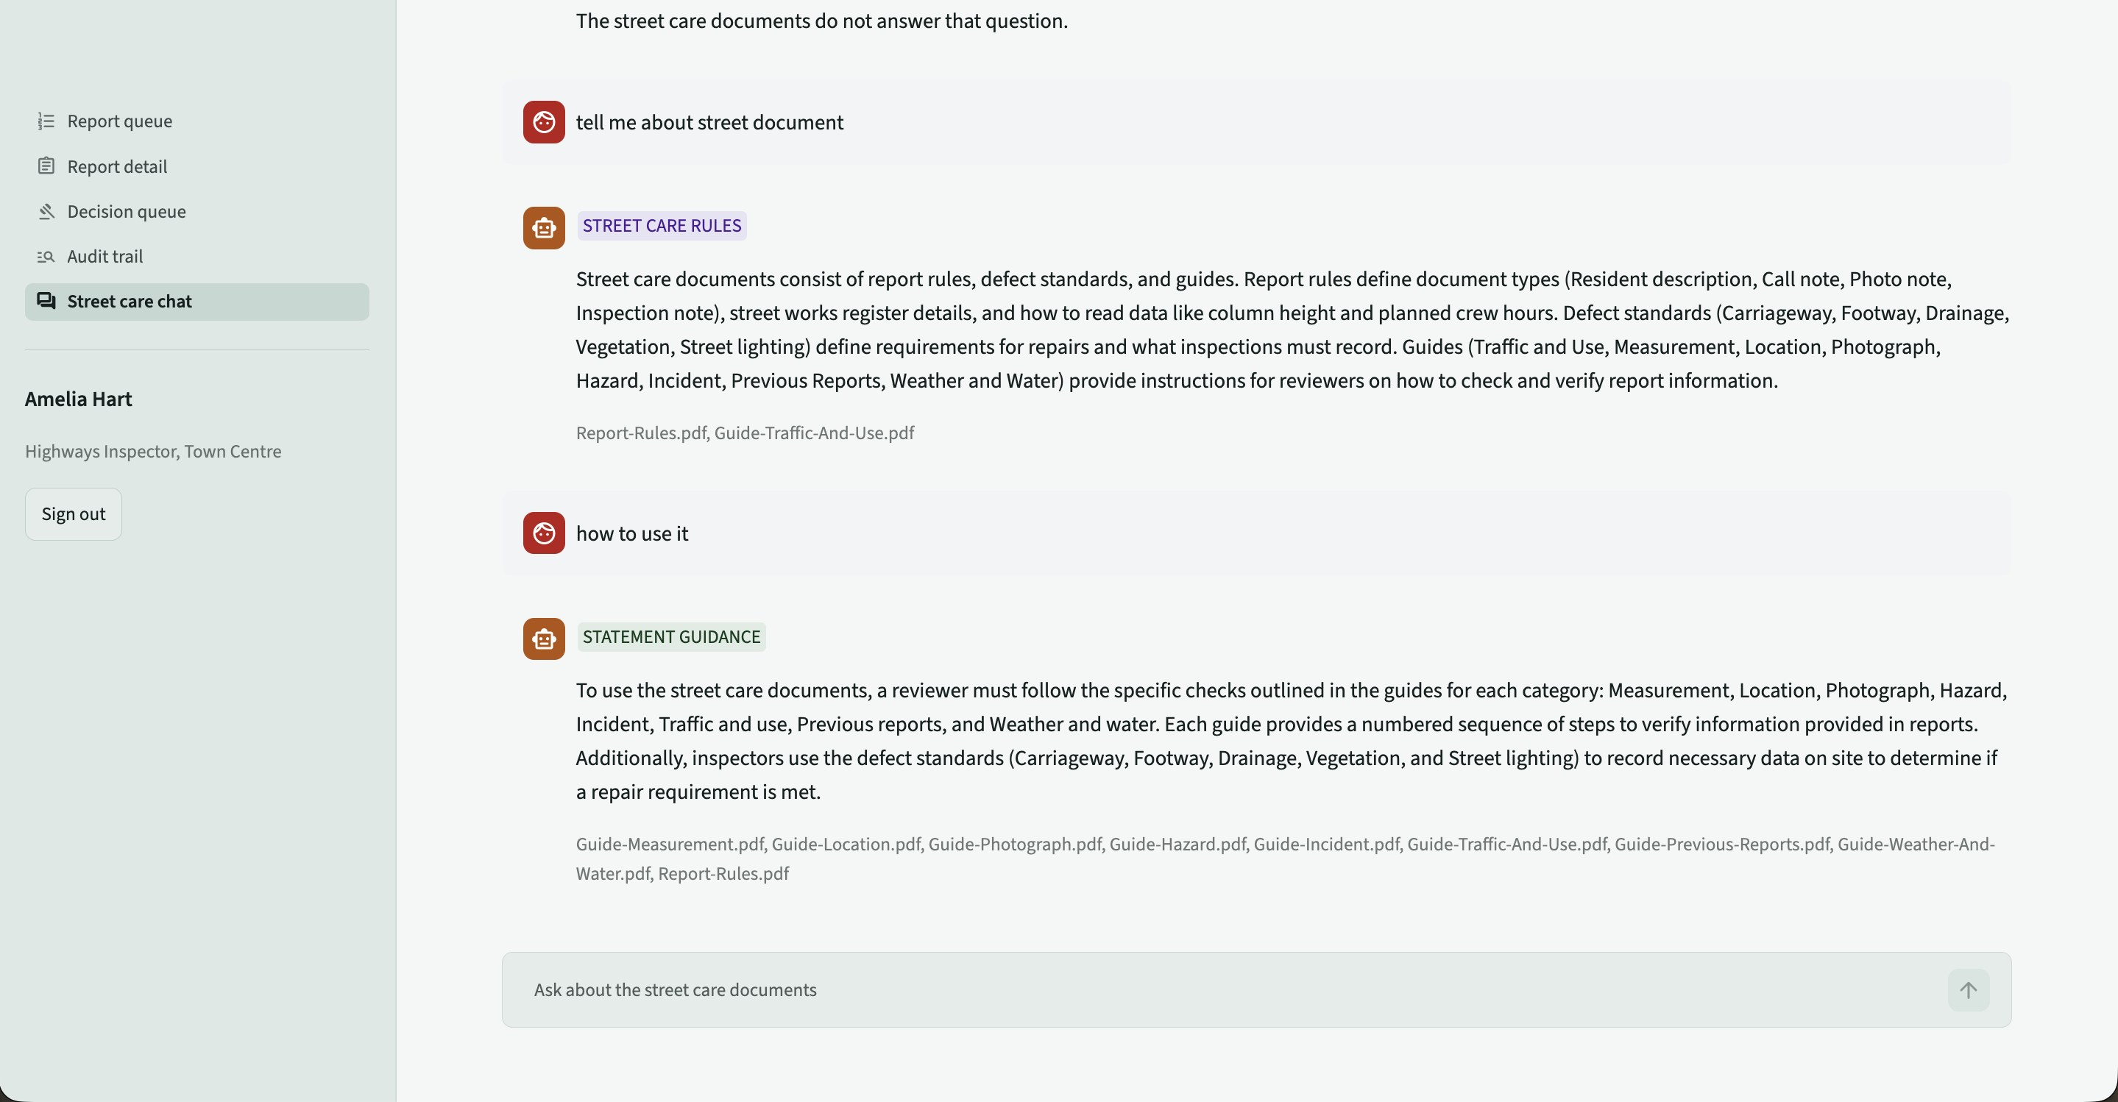
Dashboard – decision, audit and chat
The inspector decides; every question and every AI call is audited
Decision queue
Audit trail
Street care chat
Own district only
Never own review
Call budget
Grounded chat
reviews waiting on the inspector's streets
form hidden for the opener
calls vs expected, tokens, latency
sources shown under each answer
12

Slide 13
Testing my theme
Service tests run against the real FastAPI app, models and data through FastAPI's TestClient
Test | What it proves | Result
sign_in_and_out_decide_access | hashing, one session, sign-out | pass
roles_reach_permissions_and_districts | every role × permission probe; district rule | pass
queue_order_and_rows_match_detail | footway first; rows equal their detail; 422 filters | pass
run_waits_for_appointed_inspector | own review 409, other district 403 | pass*
decision_once_refusals_before_calls | 422s, second review 409, decided once | pass*
Design challenges and solutions
Permissions for URLs with ids
looked up by route template, e.g. /reviews/{review_id}/decision
Decimal rules not JSON
converted to numbers in the report detail
Stale sessions
sign-in replaces the stored token: one session per account
* needs the Gemini key; verified end to end with a stand-in model. Full suite: 50 / 50 with the key.
Failed AI runs
failure handler marks the run FAILED with its calls
50/50
tests pass with the key
75
API requests captured
Two people deciding at once
a lock per report around review and decision
13

Slide 14
Learnings and next steps
What building the serving layer taught me, and how I would take it further
Learned
Delivered
Next
Put every rule in the service, never the UI
11 secured endpoints with 401–502 handling
Containerise API and dashboard (Docker)
Check permissions before reading any data
Role- and district-aware dashboard with 5 pages
HTTPS, rate limiting and token expiry
Refuse before spending an AI call
Session, call-budget and chat audit trail
Reload the queue without a restart
Make failures visible and recoverable
All service tests passing
PostgreSQL for multi-instance deployment
14

Slide 15

Thank you
Questions?

